Slide 1
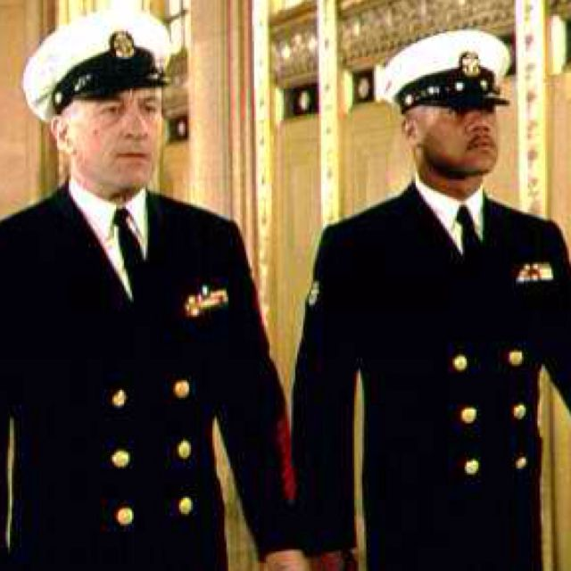

Men of Honor - Film Analysis
An Analysis of Interpersonal Communication Concepts
By Morgan Browning

Slide 2
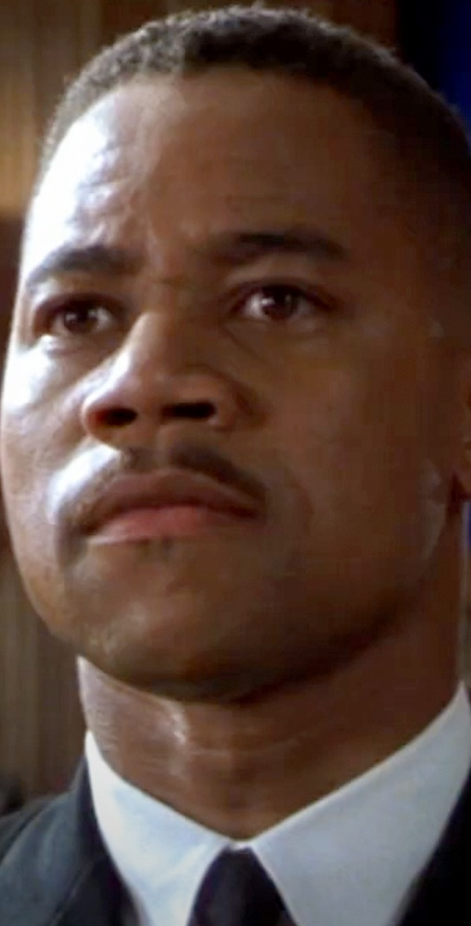
Competent Communicator & Mediated Communication
Carl Brashear is the most competent communicator in Men of Honor. He demonstrates perseverance, clear communication, and leadership. Over the course of the film, his communication evolves as he gains confidence and commands respect. Mediated communication appears through letters and reports, impacting how messages are received and interpreted.

Slide 3
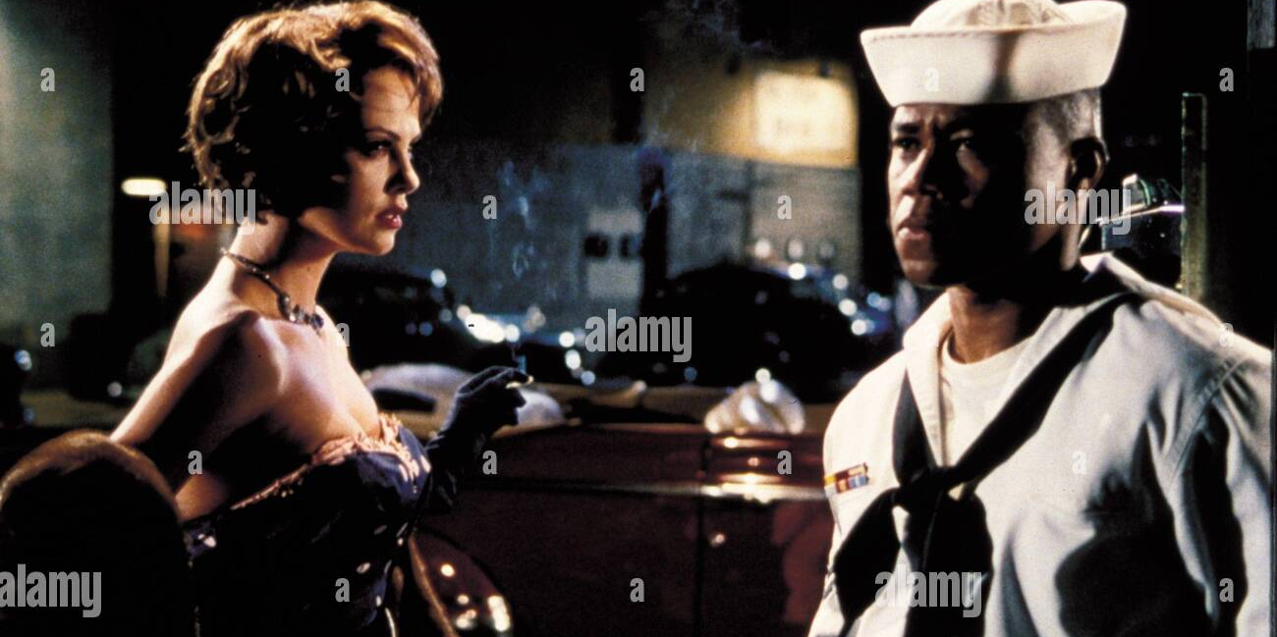
Cultural Differences & Self-Concept
Cultural barriers play a major role in the film, especially regarding race and hierarchy. Carl faces discrimination but continues to prove his abilities. His self-concept is built on determination and proving himself against societal expectations. This impacts how he communicates—assertively and with purpose.

Slide 4
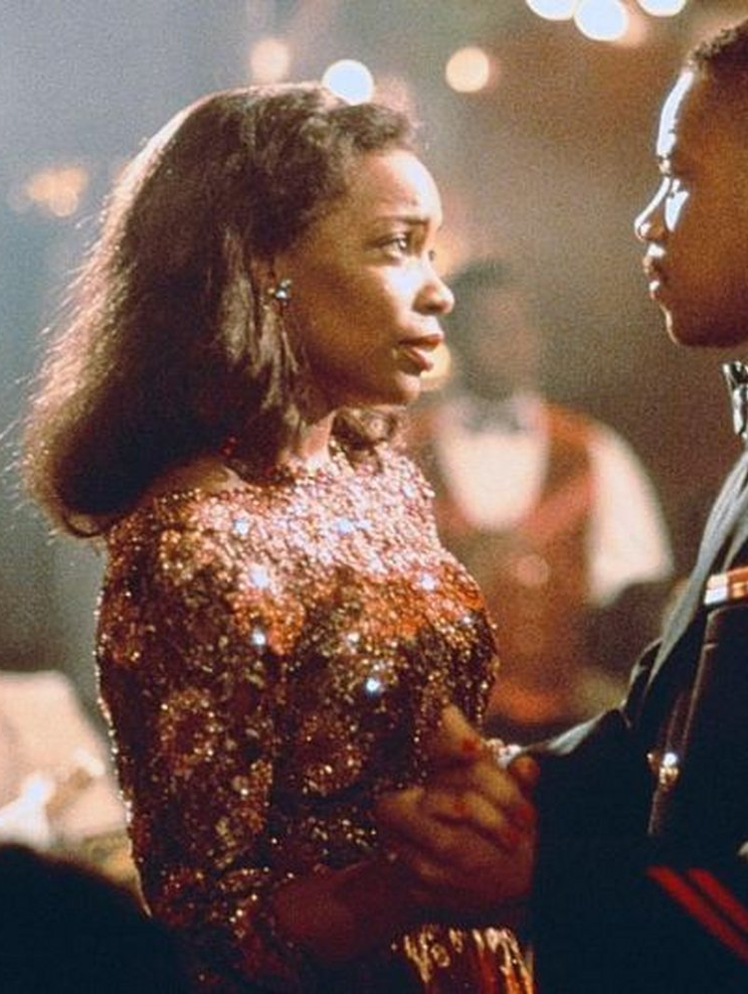
Perception & Listening
Others perceive Carl as incapable at first due to racial biases. Over time, his actions force them to reconsider. His persistence changes their perception. Listening is crucial in the film—characters must hear and understand each other. Examples include Carl listening to instructors to master skills and his superior officers eventually listening to his arguments for fairness.

Slide 5
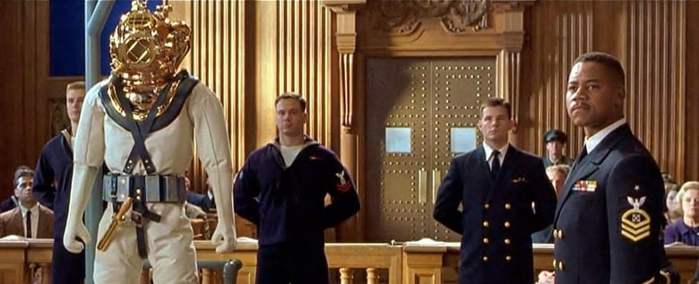
Language & Nonverbal Communication
Language plays a big role—commands, insults, and motivational words shape interactions. Examples include Carl’s exchanges with his instructor, courtroom dialogues, and orders on deck. Nonverbal communication is equally powerful: facial expressions of doubt, nods of approval, and military discipline all convey meaning.

Slide 6
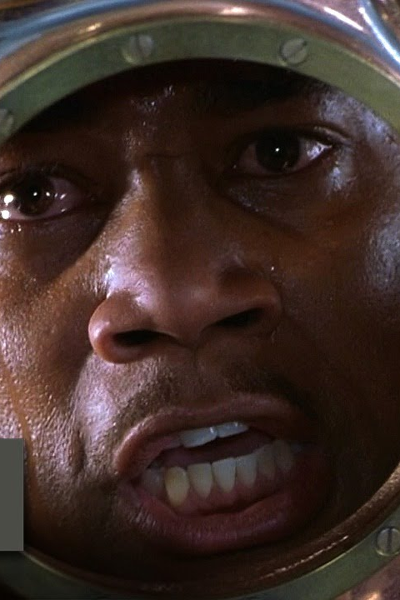
Emotions & Conflict
Characters express emotions through body language and tone. Examples include Carl’s frustration when underestimated, his determination in training, and his pride when achieving his goal. Conflict is a driving force—Carl faces institutional resistance and personal rivalries, which he overcomes through perseverance.

Slide 7
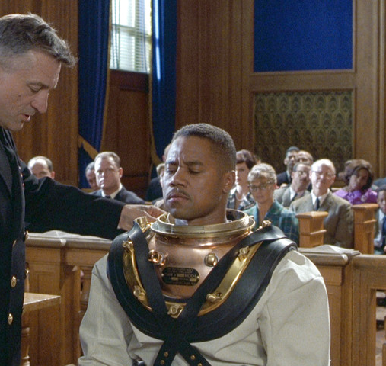
Relationships & Interpersonal Attraction
Carl forms a mentor-student relationship with Billy Sunday, built on mutual respect. One key aspect of attraction is Carl’s unwavering dedication, which earns respect. The film portrays Knapp’s Relational Stages through Carl’s evolving relationships—from hostility to respect with his superiors and colleagues.

Slide 8
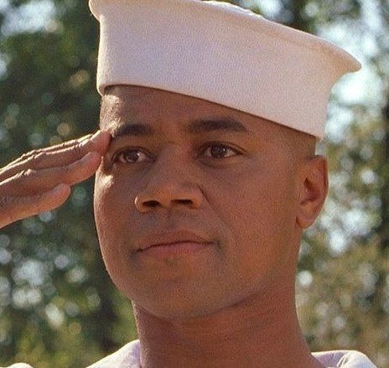
References
1. Landry, L. (2023, February 14). 8 essential leadership communication skills. Harvard Business School Online. https://online.hbs.edu/blog/post/leadership-communicationLinks to an external site.
2. Margolis, J. D., & Stoltz, P. G. (2010). How to bounce back from adversity. Harvard Business Review. https://hbr.org/2010/01/how-to-bounce-back-from-adversityLinks to an external site.

